Slide 1
Map Reduce

Slide 2
From Previous session

Slide 3
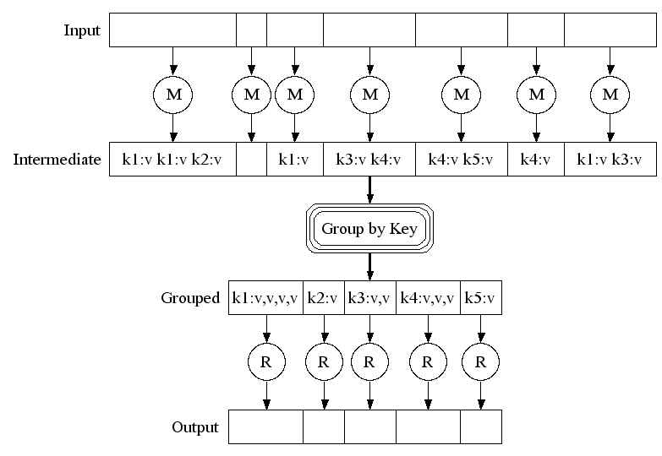
Map-Reduce: A diagram
Big document
MAP:
Read input and produces a set of key-value pairs
Group by key:
Collect all pairs with same key
(Hash merge, Shuffle, Sort, Partition)
Reduce:
Collect all values belonging to the key and output

Slide 4
Map Reduce Algorithms

Slide 5
Matrix-Vector Multiplication
Suppose we have an n×n matrix M, whose element in row i and column j will be denoted m_{ij} .
Suppose we also have a vector v of length n, whose jth element is v_{j} .
Then the matrix-vector product is the vector x of length n, whose ith element x_{i} is given by
Assumption: Matrix M and vector v are stored in DFS, such that their row-column coordinates are either discoverable from file position or explicitly specified as (i, j, m_{ij}) & (j, v_{j})

Slide 6
Matrix-Vector Multiply : Case 1
Case 1: Vector v can fit in memory
Hence, vector v available to every Map task
The Map function:
Vector v is entirely read into memory of the node executing a Map task (if not already read).
Each Map task will operate on a chunk of matrix M
For each matrix element m_{ij}, Map task produces key-value pair as (i, m_{ij} * v_{j})
NOTE: All terms that will sum-up to give component of x, have same key i
The Reduce function:
It simply sums all the values associated with a given key i and generates key-value pair (i, x_{i})

Slide 7
Matrix-Vector Multiply : Case 2
Case 2: Vector v cannot fit in memory
Hence, divide the vector v into an equal sized horizontal strips. Also, divide matrix M into vertical strips, of width same as height of strips of vector v.
Division of Matrix M and vector v into five strips
Each Map task is assigned a chunk from one of the stripes of Matrix M and gets corresponding stripe of vector v.

Slide 8
Relational Algebra Operations
Select:
Project:
Set Operations:
Union
Intersect
Set Difference
Natural Join: R(A,B) ⋈ S(B,C)

Slide 9
Map-Reduce Join
Use a hash function h from B-values to 1...k
A Map process turns:
Each input tuple R(a,b) into key-value pair (b,(a,R))
Each input tuple S(b,c) into (b,(c,S))
Map processes send each key-value pair with key b to Reduce process h(b)
Hadoop does this automatically; just tell it what k is.
Each Reduce process matches all the pairs (b,(a,R)) with all (b,(c,S)) and outputs (a,b,c).

Slide 10
Grouping and Aggregation*
select θ(B) from R group by A;
NOTE – θ is any aggregation operation such as SUM, MIN, MAX, AVG, COUNT.
The Map Function: For each tuple (a, b, c) produce the key-value pair (a, b).
The Reduce Function: Each key a represents a group. Apply the aggregation operator θ to the list [b1, b2, . . . , bn] of B-values associated with key a. The output is the pair (a, x), where x is the result of applying θ to the list.

Slide 11
Sparse Matrix Multiplication
A
B
C
10
20
-1
-10
-80
30
40
X
-2
-3
=
-60
-250
50
60
70
-4
-170
-460
Task: Compute product C = A·B
Assume most matrix entries are 0
Motivation
Core problem in scientific computing
Challenging for parallel execution
Demonstrate expressiveness of MapReduce

Slide 12
Computing Sparse Matrix Product
A
B
1
10
1
1
-1
1
10
20
A
-1
B
1
20
3
2
-2
1
30
40
A
-2
-3
B
2
30
2
2
-3
2
50
60
70
A
-4
B
2
40
3
3
-4
2
A
B
3
50
1
A
3
60
2
A
3
70
3
A
Represent matrix as list of nonzero entries
⟨row, col, value, matrixID⟩
Strategy
Phase 1: Compute all products a_{i,k} · b_{k,j}
Phase 2: Sum products for each entry i,j
Each phase involves a Map/Reduce

Slide 13
Phase 1 Map of Matrix Multiply
1
10
1
Key = 1
A
10
1
20
3
1
A
1
A
1
-1
1
30
50
B
2
2
3
A
1
A
2
40
3
Key = col
A
Key = 2
3
50
1
2
30
2
2
-2
1
A
A
B
3
60
2
60
2
-3
2
A
3
A
2
B
3
70
3
A
1
-1
1
Key = 3
B
1
20
3
2
-2
1
A
Key = row
B
40
3
-4
2
2
-3
2
2
A
3
B
B
3
-4
2
3
70
3
B
A
Group values a_{i,k} and b_{k,j} according to key k

Slide 14
Phase 1 Reduce of Matrix Multiply
Key = 1
1
-10
1
1
10
1
C
A
X
1
-1
1
-50
B
3
C
1
3
50
1
A
2
-60
1
Key = 2
C
2
30
2
2
-2
1
2
-90
2
A
X
B
C
60
2
-3
2
3
-120
1
3
A
2
B
C
3
-180
2
C
Key = 3
20
1
-80
2
1
A
3
C
-4
2
-160
2
2
40
3
X
3
B
2
C
A
-280
3
C
2
3
70
3
A
Generate all products a_{i,k} · b_{k,j}

Slide 15
Phase 2 Map of Matrix Multiply
-10
-10
1
1
Key = 1,1
C
1
C
1
3
-50
1
-80
Key = 1,2
C
1
C
2
-60
Key = 2,1
2
1
2
-60
1
C
C
2
-90
2
Key = row,col
Key = 2,2
C
2
-90
2
-120
C
3
C
1
2
-160
2
-180
C
3
C
2
-120
Key = 3,1
3
C
1
1
-80
2
-50
C
3
C
1
2
-160
2
C
Key = 3,2
3
-280
2
3
-280
2
C
C
-180
3
C
2
Group products a_{i,k} · b_{k,j} with matching values of i and j

Slide 16
Phase 2 Reduce of Matrix Multiply
-10
-10
Key = 1,1
1
C
1
1
C
1
-80
-80
Key = 1,2
1
C
2
1
C
2
Key = 2,1
2
-60
1
2
-60
1
C
C
C
Key = 2,2
-10
-80
2
-90
2
-250
C
2
C
2
-60
-250
2
-160
2
C
-170
-460
-120
-170
Key = 3,1
3
C
1
3
C
1
3
-50
1
C
Key = 3,2
3
-280
2
-460
C
3
C
2
3
-180
2
C
Sum products to get final entries

Slide 17
Matrix Multiply: One MapReduce step
Consider multiplication of 2 matrices A and B
The Map Function:
For each element a_{ik} of A, produce all the key-value pairs ((i, x), (A, k,a_{ik} )) for x = 1, 2, . . ., up to the number of columns of B.
Similarly, for each element b_{kj} of B, produce all the key-value pairs((y, j), (B, k, b_{kj})) for y = 1, 2, . . ., up to the number of rows of A.

Slide 18
Matrix Multiply: One MapReduce step
Intermediate Shuffle and Sort: Each key (i, j) will have an associated list with all the values (A,k,a_{ik}) and (B, k, b_{kj}), for all possible values of k.
The Reduce Function: The Reduce function needs to connect the two values on the list that have the same value of k, for each k.
An easy way to do this step is to sort by k the values that begin with A and sort by k the values that begin with B, in separate lists.
The kth values on each list must have their third components ( i.e. a_{ik} and b_{kj} ) multiplied. Then, these products are summed and the result is paired with (i,j) in the output of the Reduce function.

Slide 19
Cost Measures for Algorithms
In Parallel Algorithms we quantify the cost of an algorithm using
Communication cost = total I/O of all processes
Elapsed communication cost = max of I/O along any path
(Elapsed) computation cost analogous, but count only running time of processes
Note that here the big-O notation is not the most useful (adding more machines is always an option)

Slide 20
Example: Cost Measures
For a map-reduce algorithm:
Communication cost = input file size + 2 × (sum of the sizes of all files passed from Map processes to Reduce processes) + the sum of the output sizes of the Reduce processes.
Elapsed communication cost is the sum of the largest input + output for any map process, plus the same for any reduce process
(Elapsed) computation cost is wall-clock time using parallelism

Slide 21
What Cost Measures Mean
Either the I/O (communication) or processing (computation) cost dominates
Ignore one, the other can be minimized
Total cost tells what you pay in rent from your friendly neighborhood cloud

Slide 22
Key Limitations of Hadoop
Issues with small files: HDFS is better in handling small number of large files than large number of small files
Reason: NameNode will get overloaded
Slow processing speed: MapReduce latency for several parallel algorithms.
Reason: Dividing every tasks into Map and Reduce and data conversion to key-value pairs
Support for batch processing only: Slower for stream data. Not suitable for real-time DP
Reason: MapReduce framework does not leverage the memory of Hadoop cluster to the maximum

Slide 23
Other limitations of Hadoop
Not efficient for Iterative processing.
MapReduce is not easy to use: Requires Hive and Pig to make working simpler
Security: Hadoop does not encrypt data at storage level
No caching of intermediate data.
No abstraction makes coding MapReduce for each operation difficult and increases LOC
Does not predict completion time

Slide 24
Conclusions
Distributed Systems Concepts Lead to Scalable Machines
Loosely coupled execution model
Lowers cost of procurement & operation
Map-Reduce Gaining Widespread Use
Hadoop makes it widely available
Great for some applications, good enough for many others
Lots of Work to be Done
Richer set of programming models, languages and implementations
Expanding range of applicability
Problems that are data and compute intensive

Slide 25
Thank You
Any Questions?

